Slide 1





One Week Training Program on Azure AI Fundamentals 22.11.2022 -- 30.11.2022
Resource Person
SCHOOL OF COMPUTER SCIENCE & ARTIFICIAL INTELLIGENCE

Slide 2

Azure AI Fundamentals (AI-900)
Dr. Venkataramana Veeramsetty
Center for AI and Deep learning
SR University, Warangal

Slide 3
Introduction to AI
AI enables us to build amazing software that can improve health care, enable people to overcome physical disadvantages, empower smart infrastructure, create incredible entertainment experiences, and even save the planet!
https://www.microsoft.com/en-us/videoplayer/embed/RE4vyDl?postJsllMsg=true

Slide 4
What is AI
Artificial intelligence is an intelligence that was developed in the form some mathematical operations and implemented using computer programming in order to make machines behaves like human intelligence to perform some task like
Decision making
Language translation
Visual perceptions
Speech recognition etc.

Slide 5
Key Elements of AI
Machine learning - This is often the foundation for an AI system, and is the way we "teach" a computer model to make prediction and draw conclusions from data.
Anomaly detection - The capability to automatically detect errors or unusual activity in a system.
Computer vision - The capability of software to interpret the world visually through cameras, video, and images.
Natural language processing - The capability for a computer to interpret written or spoken language, and respond in kind.
Conversational AI - The capability of a software "agent" to participate in a conversation.
Knowledge mining - The capability to extract information from large volumes of often unstructured data to create a searchable knowledge store.
Fuzzy Logic Systems - Mimics Human Decision Making
Swarm Intelligence – Swarm intelligence (SI) is an artificial intelligence approach which is inspired by natural behavior to solve optimization problems.

Slide 6
Understand machine learning
Machine Learning is the foundation for most AI solutions.
Sustainable farming techniques are essential to maximize food production while protecting a fragile environment. The Yield, an agricultural technology company based in Australia, uses sensors, data and machine learning to help farmers make informed decisions related to weather, soil and plant conditions.
https://www.microsoft.com/en-us/videoplayer/embed/RE4voJG?postJsllMsg=true

Slide 7
How machine learning works
https://docs.microsoft.com/en-us/learn/wwl-data-ai/get-started-ai-fundamentals/media/machine-learn.gif

Slide 8

What is machine learning?
A case study example
Adventure Works Cycles is a business that rents cycles in a city. The business could use historic data to train a model that predicts daily rental demand to make sure sufficient staff and cycles are available.

Slide 9
Learning Algorithms
Supervised Learning
Unsupervised Learning (Clustering & Association)
Semi Supervised Learning (Label and Unlabel)

Slide 10
Real time problems
Regression
Classification
Clustering

Slide 11
Regression
Simple Linear Regression
Multiple Linear Regression
Polynomial Regression

Slide 12
Advantages & Limitations of Regression
Continues value prediction
Simple to understand and implement
Simple mathematics
Much lower training time as it is simple model
Cannot perform well on complex real time problems

Slide 13
Applications
Load demand prediction
Stock price prediction
Credit score assessment

Slide 14
Classification
Binary
Categorical

Slide 15
Binary Classification Problems
Patient affected with covid or not?
Can issue credit card or not?

Slide 16
Categorical Classification Problem
Type of faults (Ex, LG, LL, LLG, LLLG)
Mood of tweet (Ex. Happy, Sad, Angry)

Slide 17
Machine learning in Microsoft Azure
Microsoft Azure provides the Azure Machine Learning service - a cloud-based platform for creating, managing, and publishing machine learning models.
Automated machine learning
Azure Machine Learning designer
Data and compute management
Pipelines

Slide 18
What is Azure Machine Learning studio?
Training and deploying an effective machine learning model involves a lot of work, much of it time-consuming and resource-intensive
Azure Machine Learning is a cloud-based service that helps simplify some of the tasks it takes to prepare data, train a model, and deploy a predictive service.
Azure Machine Learning helps data scientists increase their efficiency by automating many of the time-consuming tasks associated with training models
it enables data scientists to use cloud-based compute resources that scale effectively to handle large volumes of data while incurring costs only when actually used.

Slide 19
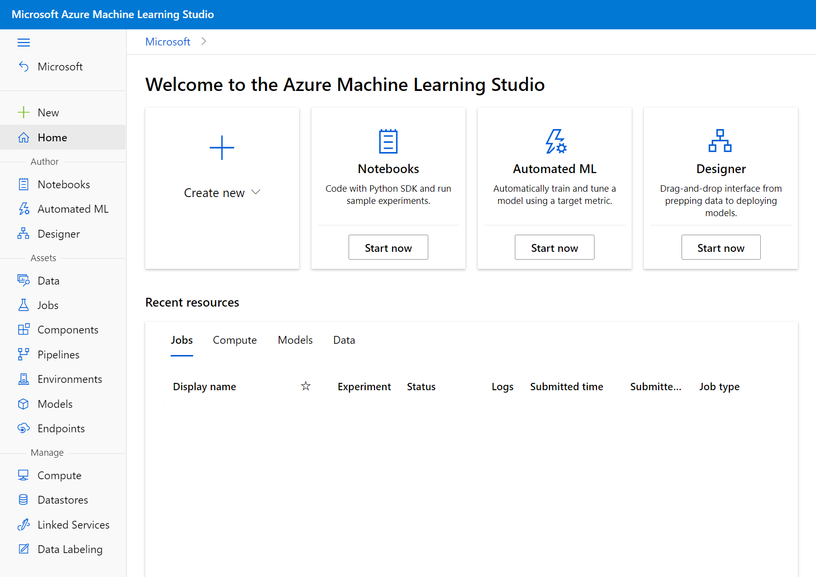
Azure Machine Learning Studio
Azure Machine Learning studio is a web portal for machine learning solutions in Azure. It includes a wide range of features and capabilities that help data scientists prepare data, train models, publish predictive services, and monitor their usage.

Slide 20
Azure Machine Learning compute
At its core, Azure Machine Learning is a service for training and managing machine learning models, for which you need compute on which to run the training process.
Compute Instances
Compute Clusters
Inference Clusters
Attached Compute

Slide 21
Compute Instance
Azure Machine Learning compute instance is an virtual machine on which you are running a notebook.
Development workstations that data scientists can use to work with data and models.

Slide 22
Compute Clusters
Scalable clusters of virtual machines for on-demand processing of experiment code.
Cost-effective way to run experiments that need to handle large volumes of data
Reduce time for parallel processing to distribute the workload

Slide 23
Attached Compute
Links to existing Azure compute resources, such as Virtual Machines or Azure Databricks clusters.
Easily attach the existing Azure Machine Learning workspace and use it as a compute target for certain workload types.

Slide 24
Inference Clusters
Deployment targets for predictive services that use your trained models.
These compute targets can be used to host models for deployment, for example, Azure Kubernetes Service cluster

Slide 25
Automated machine learning
This feature enables non-experts to quickly create an effective machine learning model from data.
Automated machine learning capability that automatically tries multiple pre-processing techniques and model-training algorithms in parallel.
Automated machine learning allows you to train models without extensive data science or programming knowledge.
For people with a data science and programming background, it provides a way to save time and resources by automating algorithm selection and hyperparameter tuning.

Slide 26
AutoML process
Prepare data: Identify the features and label in a dataset. Pre-process, or clean and transform, the data as needed.
Train model: Split the data into two groups, a training and a validation set. Train a machine learning model using the training data set. Test the machine learning model for performance using the validation data set.
Evaluate performance: Compare how close the model's predictions are to the known labels.
Deploy a predictive service: After you train a machine learning model, you can deploy the model as an application on a server or device so that others can use it.

Slide 27
Prepare data
Machine learning models must be trained with existing data. Data scientists expend a lot of effort exploring and pre-processing data, and trying various types of model-training algorithms to produce accurate models, which is time consuming, and often makes inefficient use of expensive compute hardware.
In Azure Machine Learning, data for model training and other operations is usually encapsulated in an object called a dataset. You can create your own dataset in Azure Machine Learning studio.

Slide 28
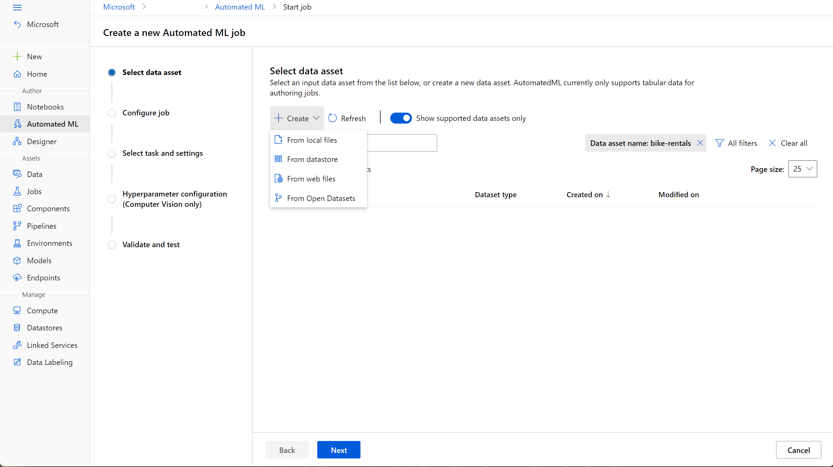
Prepare data

Slide 29
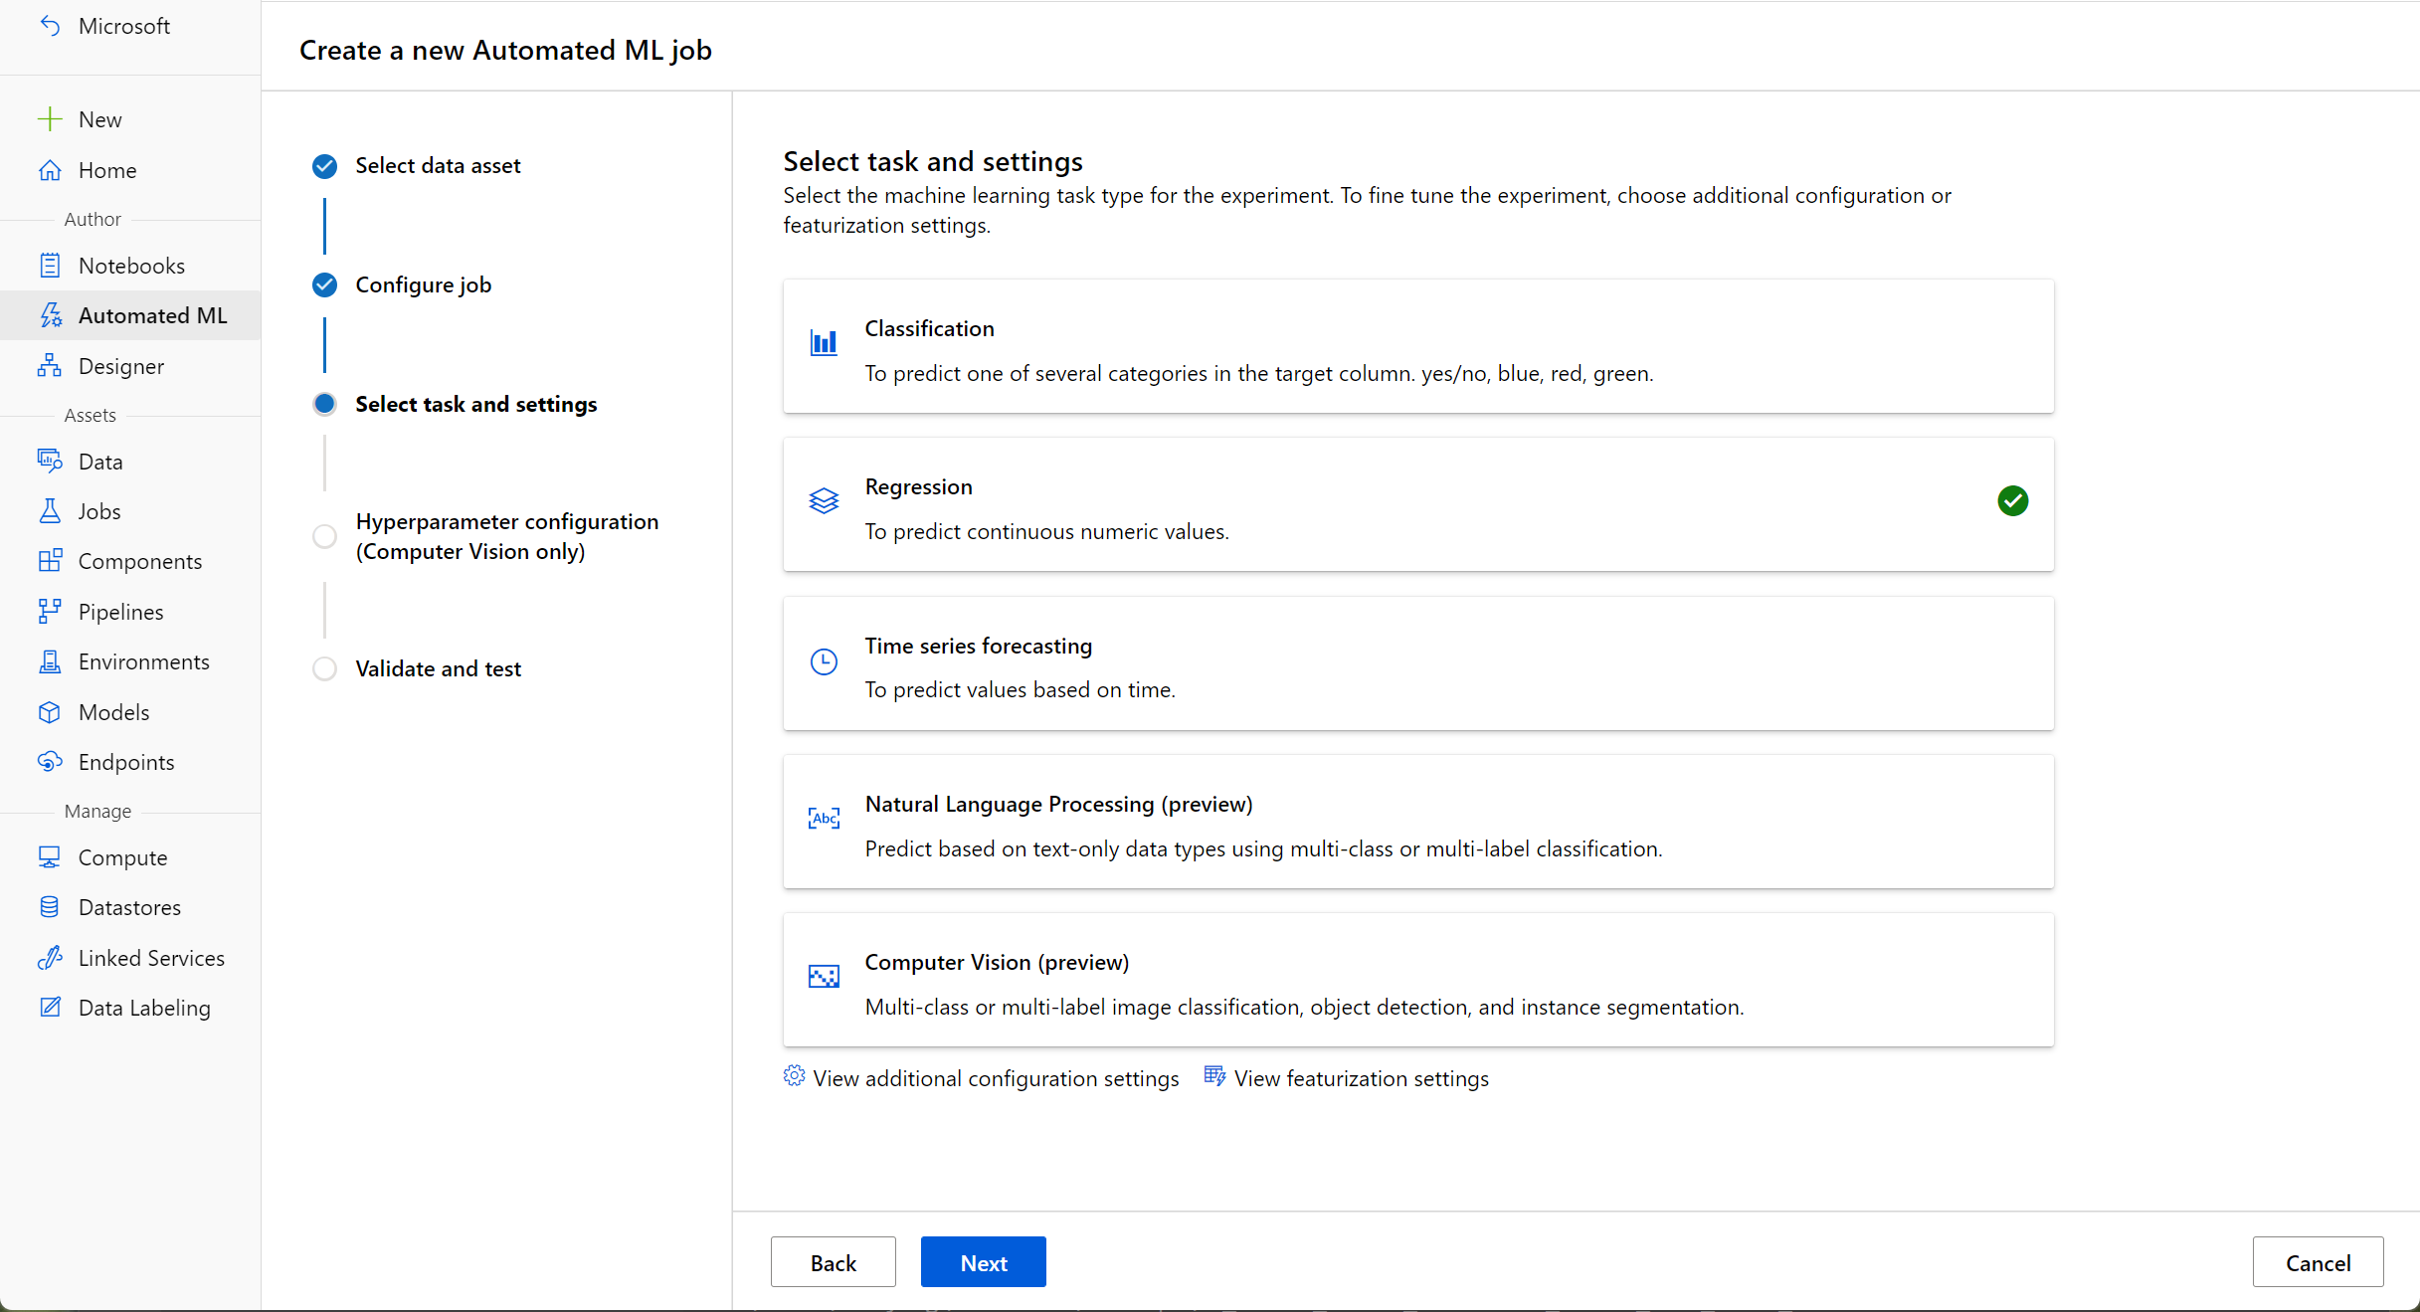
Train model
The automated machine learning capability in Azure Machine Learning supports supervised machine learning models

Slide 30
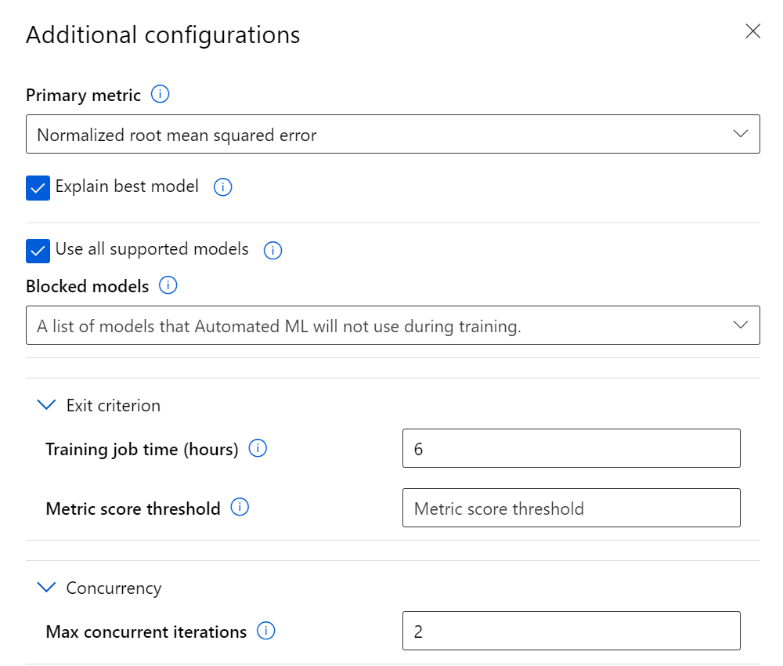
Train model

Slide 31
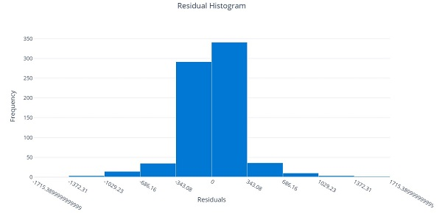
Evaluate performance
A technique called cross-validation is used to calculate the evaluation metric. After the model is trained using a portion of the data, the remaining portion is used to iteratively test, or cross-validate, the trained model. The metric is calculated by comparing the predicted value from the test with the actual known value, or label.

Slide 32
Deploy a predictive service
In Azure Machine Learning, you can deploy a service as an Azure Container Instances (ACI) or to an Azure Kubernetes Service (AKS) cluster.
For production scenarios, an AKS deployment is recommended

Slide 33
Azure Machine Learning designer
A graphical interface enabling no-code development of machine learning solutions.

Slide 34

ML Studio Classic

Slide 35
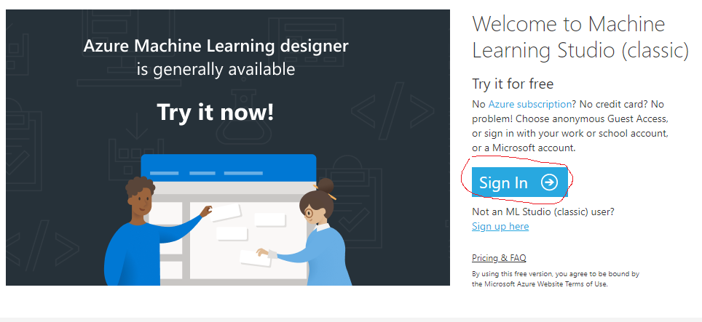
ML studio Classic
Login to portal ML studio classic : https://studio.azureml.net/

Slide 36
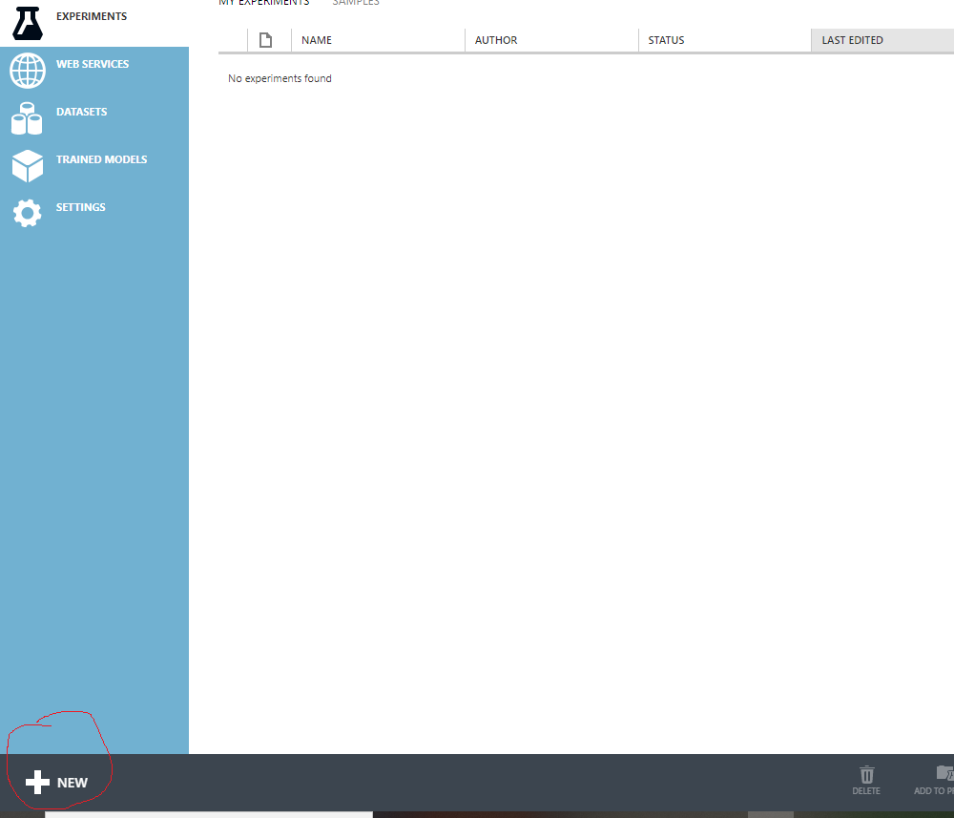
Click on "New" for New experiment

Slide 37
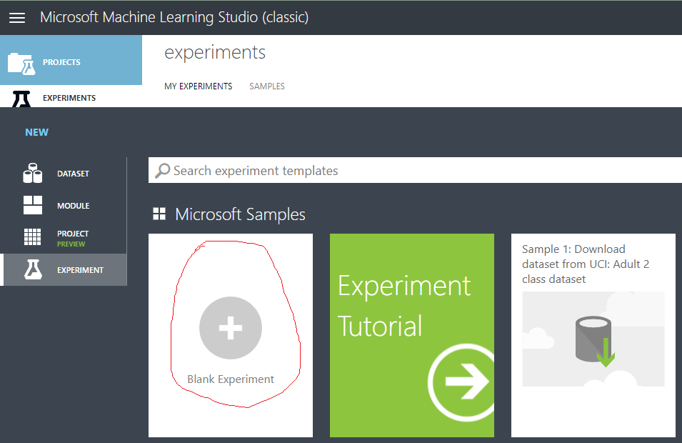

Slide 38
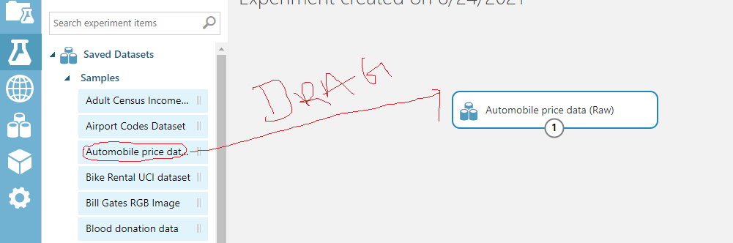
Select "Automobile Price Dataset" for Automobile price prediction project and drag

Slide 39
Missing Value Information for each Column
normalized-losses: 41
num-of-doors, horsepower, peak-rpm, :2
Bore, stroke, Price:4
wheel-basefuel-type, Make,body-style, Aspiration, Curb weight,engine-type,num-of-cylinders, engine-location, drive-wheel, length, width,hight, fuel type, engine-size, fuel system, compression-ratio, city-mpg, highway-mpg, :0

Slide 40
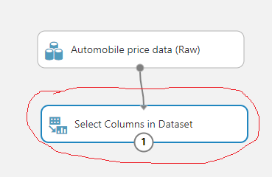
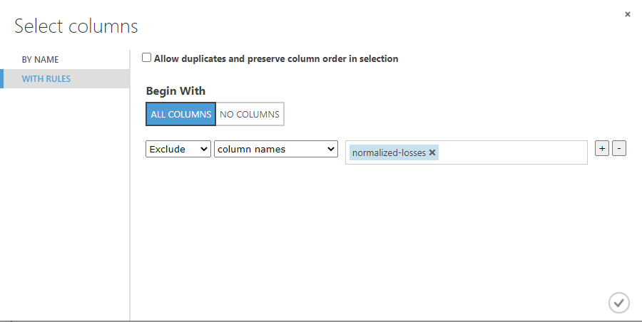
Remove "Normalized loss column due to more missing values"

Slide 41
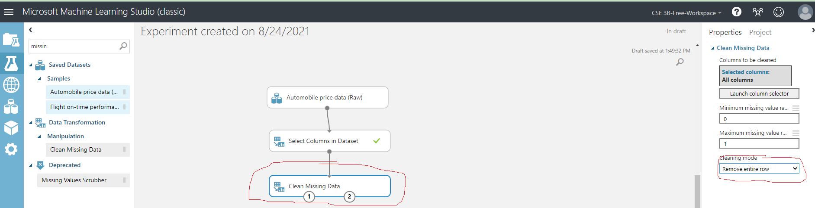
Missing Values Treatment

Slide 42
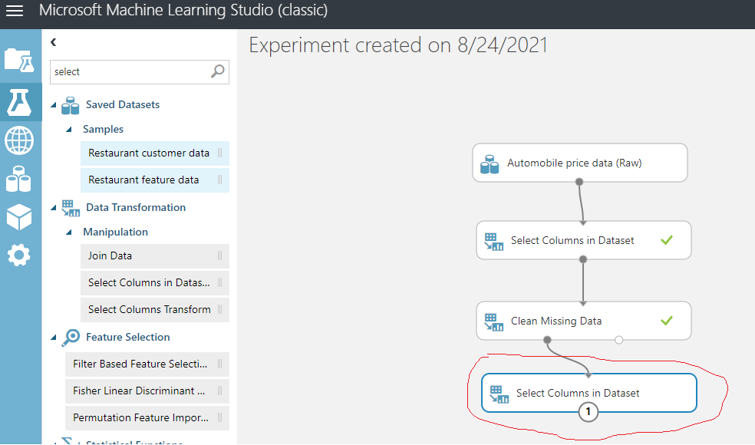
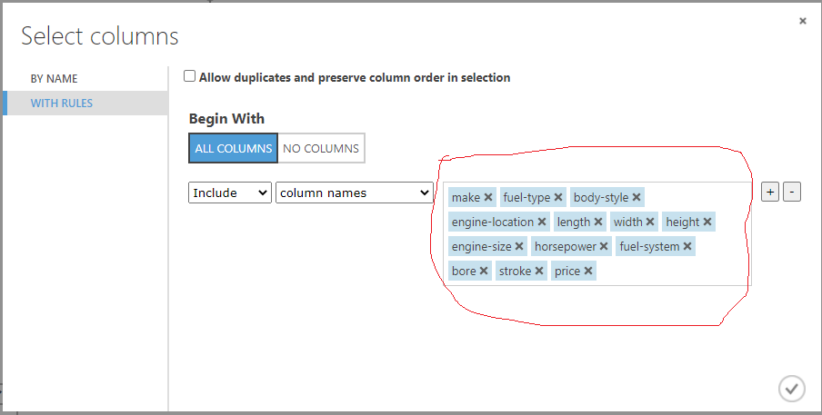
Feature Engineering

Slide 43
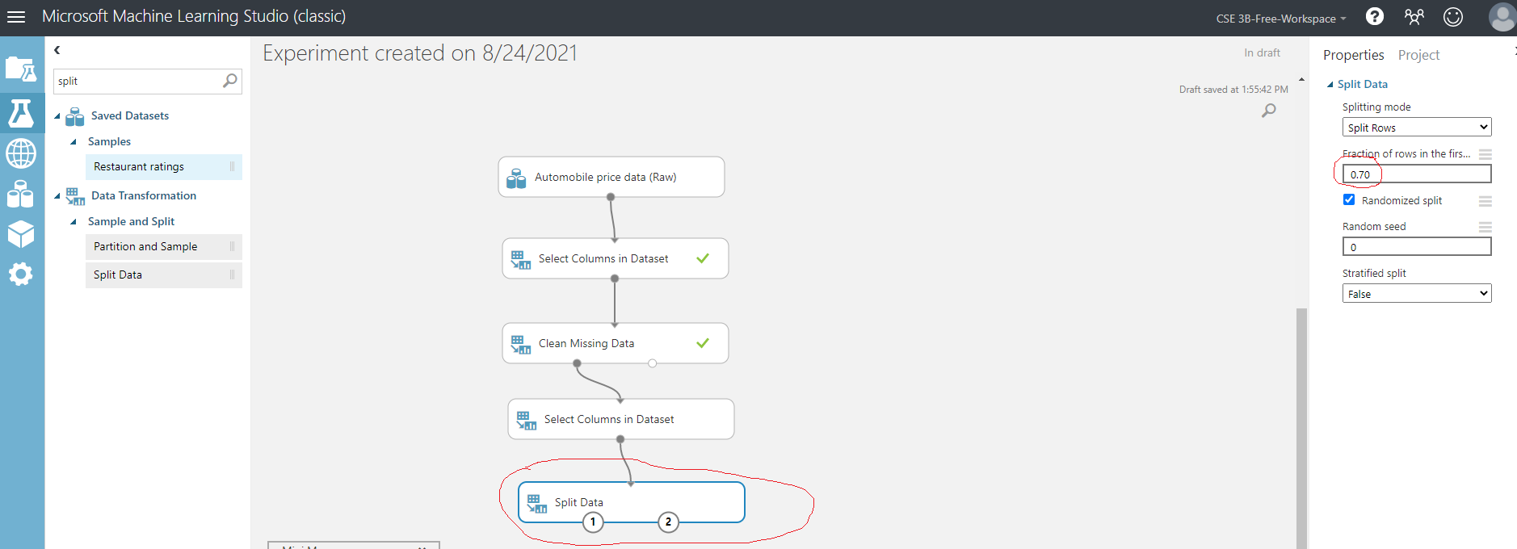
Data Split

Slide 44
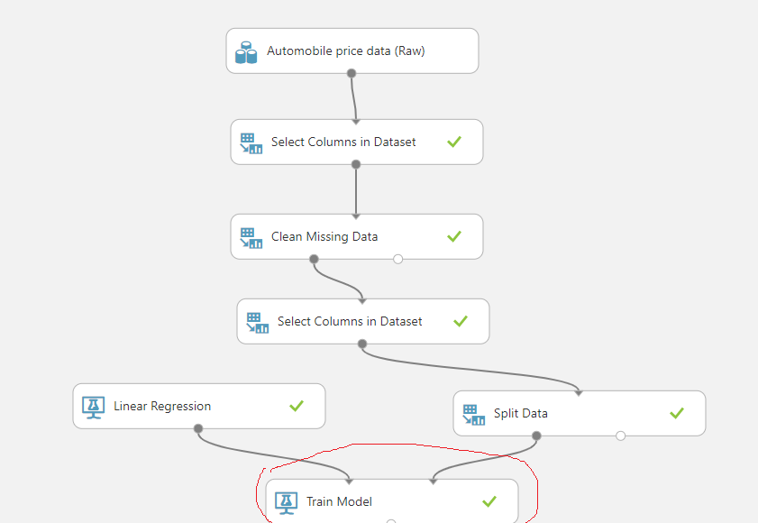
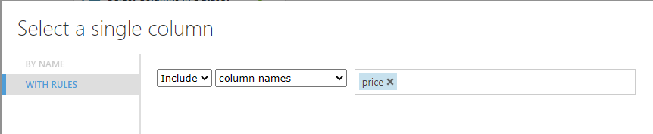
Train Model (Linear Regression Model)

Slide 45
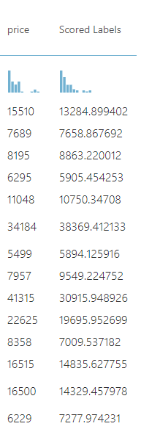
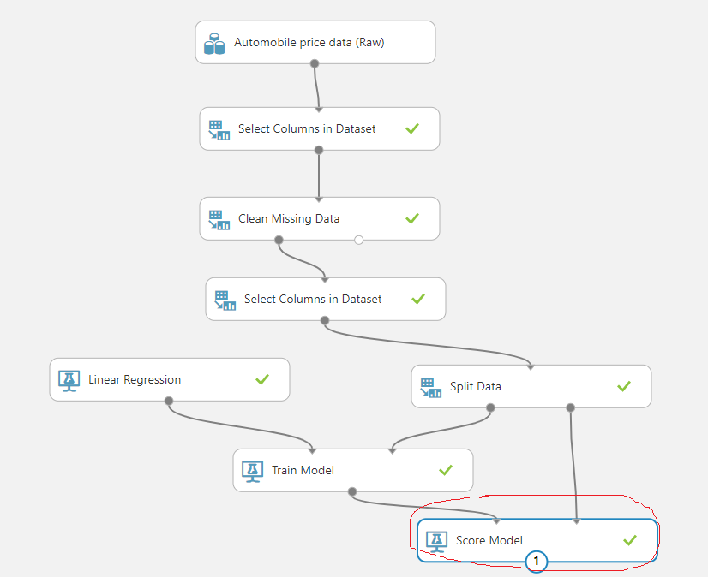
Test Model

Slide 46
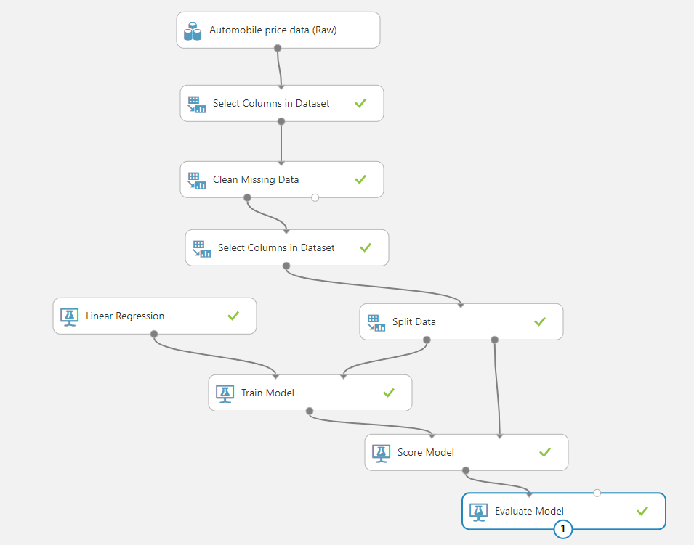
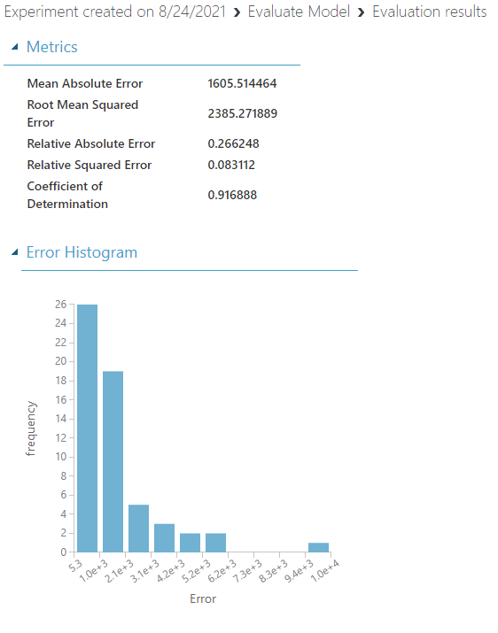
Evaluate Model

Slide 47
Data and compute management
Cloud-based data storage and compute resources that professional data scientists can use to run data experiment code at scale.

Slide 48
Pipeline
Data scientists, software engineers, and IT operations professionals can define pipelines to orchestrate model training, deployment, and management tasks.

Slide 49
Understand anomaly detection
Imagine you're creating a software system to monitor credit card transactions and detect unusual usage patterns that might indicate fraud.
An application that tracks activity in an automated production line and identifies failures.
A racing car telemetry system that uses sensors to proactively warn engineers about potential mechanical failures before they happen.
https://docs.microsoft.com/en-us/learn/wwl-data-ai/get-started-ai-fundamentals/media/anomaly-detection.gif

Slide 50
Understand computer vision
Computer Vision is an area of AI that deals with visual processing. Seeing AI
Image classification
Object detection
Semantic segmentation
Image analysis
Face detection, analysis, and recognition
Optical character recognition (OCR)

Slide 51
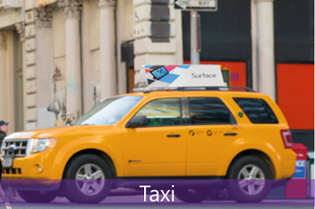
Image classification
Image classification involves training a machine learning model to classify images based on their contents. For example, in a traffic monitoring solution you might use an image classification model to classify images based on the type of vehicle they contain, such as taxis, buses, cyclists, and so on.

Slide 52
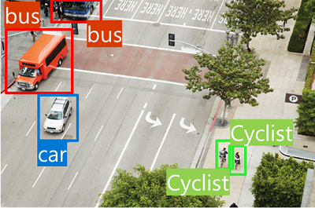
Object detection
Object detection machine learning models are trained to classify individual objects within an image and identify their location with a bounding box. For example, a traffic monitoring solution might use object detection to identify the location of different classes of vehicle.

Slide 53
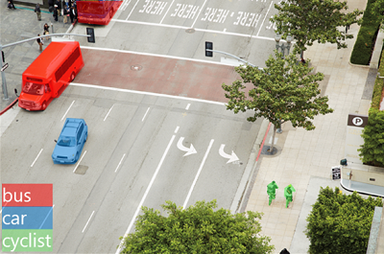
Semantic segmentation
Semantic segmentation is an advanced machine learning technique in which individual pixels in the image are classified according to the object to which they belong. For example, a traffic monitoring solution might overlay traffic images with "mask" layers to highlight different vehicles using specific colors.

Slide 54
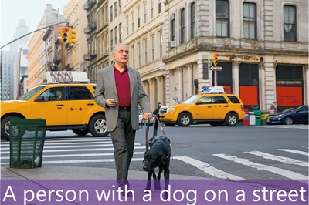
Image analysis
You can create solutions that combine machine learning models with advanced image analysis techniques to extract information from images, including "tags" that could help catalog the image or even descriptive captions that summarize the scene shown in the image.

Slide 55
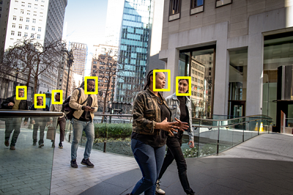
Face detection, analysis, and recognition
Face detection is a specialized form of object detection that locates human faces in an image. This can be combined with classification and facial geometry analysis techniques to infer details such as age and emotional state; and even recognize individuals based on their facial features.

Slide 56

Optical character recognition (OCR)
Optical character recognition is a technique used to detect and read text in images.

Slide 57
Computer vision services in Microsoft Azure
Computer Vision--You can use this service to analyze images and video, and extract descriptions, tags, objects, and text.
Custom Vision--Use this service to train custom image classification and object detection models using your own images.
Face--The Face service enables you to build face detection and facial recognition solutions.
Form Recognizer-- Use this service to extract information from scanned forms and invoices.
https://aidemos.microsoft.com/computer-vision

Slide 58

CoinNet: A Mobile App
Center for AI and Deep Learning, Developed an AI based Mobile Application to identify Indian Currency
This app can be helpful for the visually impaired people to recognize currency notes

Slide 59
Natural language processing
Natural language processing (NLP) is the area of AI that deals with creating software that understands written and spoken language
Analyze and interpret text in documents, email messages, and other sources.
Interpret spoken language and synthesize speech responses.
Automatically translate spoken or written phrases between languages
Interpret commands and determine appropriate actions.

Slide 60
Example
Starship Commander, is a virtual reality (VR) game from Human Interact, that takes place in a science fiction world. The game uses natural language processing to enable players to control the narrative and interact with in-game characters and starship systems.
https://www.microsoft.com/en-us/videoplayer/embed/RE4vyDj?postJsllMsg=true

Slide 61
Natural language processing in Microsoft Azure
In Microsoft Azure, you can use the following cognitive services to build natural language processing solutions:
Text Analytics: Use this service to analyze text documents and extract key phrases, detect entities (such as places, dates, and people), and evaluate sentiment (how positive or negative a document is)
Translator Text: Use this service to translate text between more than 60 languages.
Speech: Use this service to recognize and synthesize speech, and to translate spoken languages
Language Understanding Intelligent Service (LUIS): Use this service to train a language model that can understand spoken or text-based commands
https://aidemos.microsoft.com/luis/demo

Slide 62
Conversational AI
Conversational AI is the term used to describe solutions where AI agents participate in conversations with humans
Conversational AI solutions use bots to manage dialogs with users.
These dialogs can take place through web site interfaces, email, social media platforms, messaging systems, phone calls, and other channels.

Slide 63
Where we can use
Customer support for products or services.
Reservation systems for restaurants, airlines, cinemas, and other appointment-based businesses.
Health care consultations and self-diagnosis.
Home automation and personal digital assistants
https://www.microsoft.com/en-us/videoplayer/embed/RE4vC2P?postJsllMsg=true

Slide 64
Conversational AI in Microsoft Azure
QnA Maker
Azure Bot Service

Slide 65
QnA Maker
This cognitive service enables you to quickly build a knowledge base of questions and answers that can form the basis of a dialog between a human and an AI agent.
QnA service can only retrieve answers from the Knowledgebase, nothing else. You can think it as a fancier Database, you can query it using human language.

Slide 66
Azure Bot Service
This service provides a platform for creating, publishing, and managing bots.
Developers can use the Bot Framework to create a bot and manage it with Azure Bot Service - integrating back-end services like QnA Maker and LUIS, and connecting to channels for web chat, email, Microsoft Teams, and others.
https://www.microsoft.com/en-us/research/project/health-bot/

Slide 67

Practice Questions ?

Slide 68
You want to create a model to predict sales of ice cream based on historic data that includes daily ice cream sales totals and weather measurements. Which Azure service should you use?
Azure Machine Learning
QnA Maker
Text Analytics

Slide 69
You want to train a model that classifies images of dogs and cats based on a collection of your own digital photographs. Which Azure service should you use?
Computer Vision
Custom Vision Azure Bot Service

Slide 70
You are designing an AI application that uses computer vision to detect cracks in car windshields, and warns drivers when a windshield should be repaired or replaced. When tested in good lighting conditions, the application successfully detects 99% of dangerously damaged glass. Which of the following statements should you include in the application's user interface?
When used in good lighting conditions, this application can be used to identify potentially dangerous cracks and defects in windshields. If you suspect your windshield is damaged, even if the application does not detect any defects, you should have it inspected by a professional.
This application detects damage in your windshield. If the application detects a defect, have the windshield replaced or repaired. If no defect is detected, you're good to go!
This application detects damage in any glass surface, but you must accept responsibility for using it only in appropriate lighting conditions.

Slide 71


Slide 72
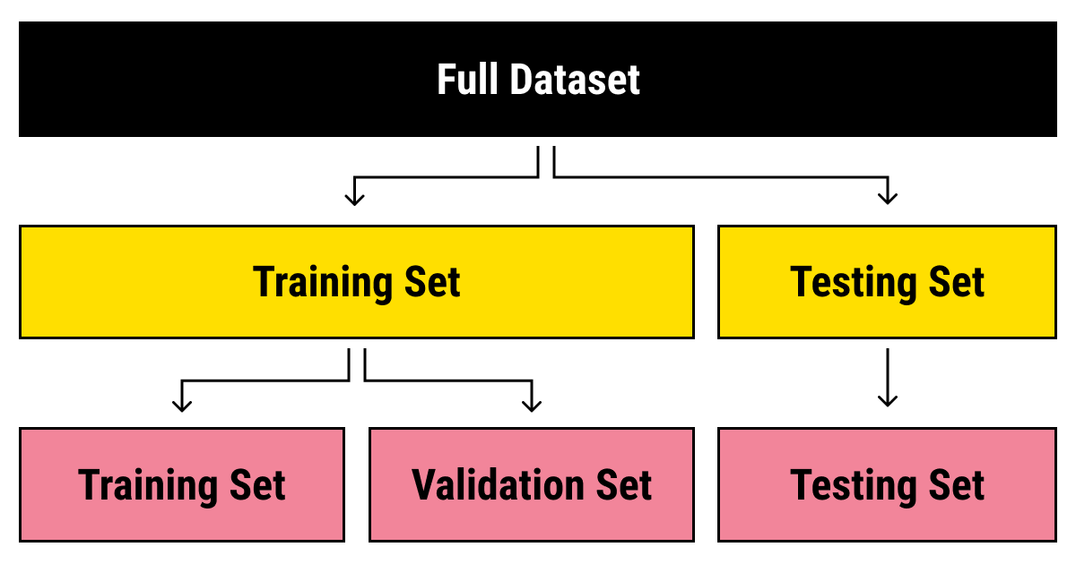
Data Split

Slide 73
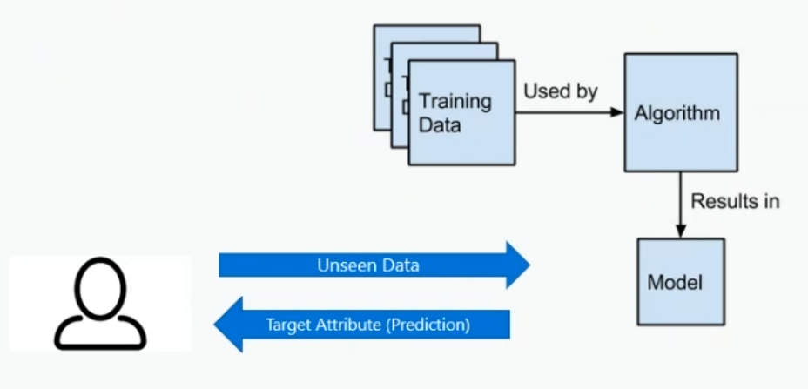
What is a Model

Slide 74
Challenges in AI
Bias – Amazon recruitment tool bias against women
Errors – Autonomous vehicle may face collision
Data could be exposed – Medical chat bot my expose sensitive patient data
Solutions may not work for everyone - App without audio
Users must trust a complex system – AI model/system should be user friendly
Who is liable for AI driven systems? - Suspecting an innocent as a criminal based on FR

Slide 75
Principals of Responsible AI
Fairness
Reliability & Safety
Privacy & Security
Inclusiveness
Transparency
Accountability
Responsible AI

Slide 76
Fairness
AI systems should treat all people fairly
Azure Machine Learning includes the capability to interpret models and quantify the extent to which each feature of the data influences the model's prediction.
This capability helps data scientists and developers identify and mitigate bias in the model.
https://www.microsoft.com/en-us/videoplayer/embed/RE4vqfa?postJsllMsg=true

Slide 77
Fairness
suppose you create a machine learning model to support a loan approval application for a bank. The model should predict whether the loan should be approved or denied without bias.
This bias could be based on gender, ethnicity (region), or other factors that result in an unfair advantage or disadvantage to specific groups of applicants.

Slide 78
Reliability & Safety
AI systems should perform reliably and safely.
For example, consider an AI-based software system for an autonomous vehicle; or a machine learning model that diagnoses patient symptoms and recommends prescriptions. Unreliability in these kinds of system can result in substantial risk to human life.
AI-based software application development must be subjected to rigorous testing and deployment management processes to ensure that they work as expected before release.
https://www.microsoft.com/en-us/videoplayer/embed/RE4vvIl?postJsllMsg=true

Slide 79
Privacy & Security
AI systems should be secure and respect privacy.
The machine learning models on which AI systems are based rely on large volumes of data, which may contain personal details that must be kept private. Even after the models are trained and the system is in production, it uses new data to make predictions or take action that may be subject to privacy or security concerns.
https://www.microsoft.com/en-us/videoplayer/embed/RE4voJF?postJsllMsg=true

Slide 80
Inclusiveness
AI systems should empower everyone and engage people.
AI should bring benefits to all parts of society, regardless of physical ability, gender, sexual orientation, ethnicity, or other factors.
https://www.microsoft.com/en-us/videoplayer/embed/RE4vl9v?postJsllMsg=true

Slide 81
Transparency
AI systems should be understandable.
Users should be made fully aware of the purpose of the system, how it works, and what limitations may be expected.
ttps://www.microsoft.com/en-us/videoplayer/embed/RE4vqfb?postJsllMsg=true

Slide 82
Accountability
People should be accountable for AI systems.
Designers and developers of AI-based solution should work within a framework of governance and organizational principles that ensure the solution meets ethical and legal standards that are clearly defined.
https://www.microsoft.com/en-us/videoplayer/embed/RE4vvIk?postJsllMsg=true

Slide 83
Microsoft AI Platform
Azure AI Services
Azure Infrastructures
Tools

Slide 84
Azure AI Services
Pre – Built AI Services (Cognitive Services (Cloud + Edge))
Conversational AI (Bot Services)
Custom AI (Azure Machine Learning Services)

Slide 85
Azure Infrastructure
AI On Data (To store data)
AI To Compute (To run machine learning models)

Slide 86
AI on Data
Cosmos DB
My SQL DB
SQL DB
Data Lake

Slide 87
AI to Compute
Spark
AKS
IoT Edge
Azure Databricks
Data Science Virtual Machines
DLVM

Slide 88
Tools
Azure ML
Deep Learning Frameworks

Slide 89
Azure ML
Azure ML VS code
Azure ML studio
Azure ML Workspace

Slide 90
Deep Learning Frameworks
Cognitive Tool Kit
TensorFlow
Caffe
SciKit Learn
Keras

Slide 91
Conda With Jupyter Notebook
Can install jupyter notebook on variety of platforms
Live code with narative text
Graphics
Audience- Developers& Data Scientists
Difficulty level- B To A
Free service

Slide 92
Jupyter Notebook
Preferable for ML tasks
Open source
Can share via GitHub, JupyterHub and Azure
Multi language support (Python, Julia and R)

Slide 93
Azure Notebooks
Azure cloud + Jupyter Notebook
Audience- Developers& Data Scientists
Difficulty level- B To A
Free Service

Slide 94
Azure Notebook
Most popular libraries pre-installed
Can Install Others
Data upload support
Leverage Azure Subscription VM
Azure Machine Learning Service

Slide 95
DSVM/DLVM
Preconfigured develoment/experimental environment
CPU or GPU based instances
Audience- Developers& Data Scientists
Difficulty level- B To A

Slide 96
Cloud based VM
Cloud workstation
Part of ML services To run jupuyter notebook
Audience- Developers& Data Scientists
Difficulty level- B To A
Run on compute target, that will cost

Slide 97
ML studio
Own graphical interface To develop ML model (Drag & Drop)
Audience- Data Scientists
Difficulty level- Beginners
Free Service

Slide 98
ML Service
Develop, Train, Evaluate and Deploy Production Grade ML models
Audience- Developers& Data Scientists
Difficulty level- B To A
Paid service

Slide 99
Visual Studio
17 languages supported
Inbuilt Git
Integrated Debugger

Slide 100

Azure Machine Learning Service

Slide 101
Machine Learning Project Workflow
Import data
Explore data (Missing Values, Outliers)
Preprocess data (Missing value imputation, outlier treatment, normalization)
Model Selection
Model Training
Model Testing
Model Deployment

Slide 102
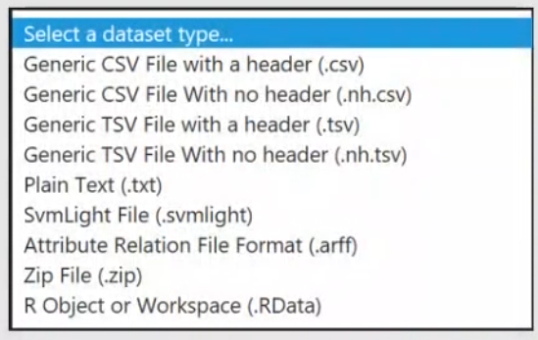
Import Data
Data Sources:
Azure blob storage
Web URL
Hadoop Using HiveQL
Azure Table Storage
Azure SQL Database
SQL Server on Azure VM
oData

Slide 103
Explore data
Identify Independent/dependent features
Outlier Identification (Box plot/z-score)
Missing Values
Any bias information
Identify similar features / unusual features
Cluster data if required
Min Max Values
Box Plot/Schattel plot/bar chart

Slide 104
Processing Data/ Data Transformation
Missing value treatment: Removal or Replace
Outlier treatment: Using Box Plot or Z-score
Normalize data: Min-Max or Standard
Data Split: Train, Validation and Test
Filtering: Remove noisy data
SMOTE: Synthetic Minority Over-Sampling Techniques (To avoid imbalance classes)

Slide 105
Model Selection: Regression
Linear Regression
Polynomial Regression
Decision Tree
Support Vector Regression
Random Forest
Neural Nets

Slide 106
Model Selection: Classification
Logistic Regression (Binary Classification)
Decision Tree
Random Forest
SVM
ANN
CNN

Slide 107
Model Selection: Clustering
K-Means
Kohenon's SOM

Slide 108
Model Training
Hyper parameter tuning
Optimizer selection
Train Model on training data and do parallel testing using validation data

Slide 109
Model Testing
Test the model on testing data
Evaluate the model in terms of metrics

Slide 110
Azure Cognitive Services

Slide 111
Azure Cognitive Services
Building AI application from scratch is complex task which involves many sub tasks
Microsoft provides Azure Cognitive Services to help developers to build application and host it
It consists APIs, SDKs and Services
Core Features: Speech, Language, Vision, Search, Decision

Slide 112
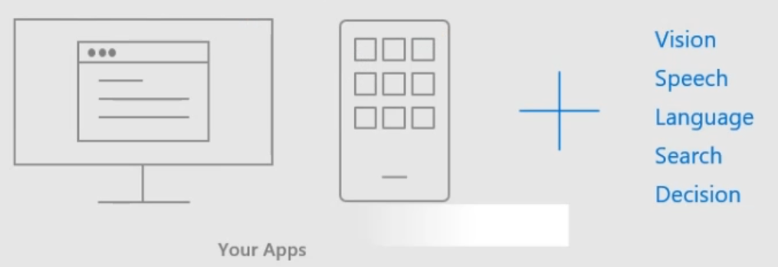

Slide 113
Azure Cognitive Services: Vision
Computer Vision
Custom Vision Service: Customized Image Classifier
Face API: Face Recognition and Attributes Detection
Video Indexer: To extract insights from video
Ink Recognizer
Form recognizer
Read API

Slide 114

Azure Cognitive Services: Speech
Text – Speech
Speech – Text
Speech Translation

Slide 115
Azure Cognitive Services: Language
Translate text
QnA maker
Text Analytics
Language Understanding

Slide 116
Language Understanding
LUIS is a cloud-based API service that applies custom machine learning intelligence to user's conversation, predict overall meaning of text, pull out relevant and detailed information

Slide 117

Thank you

